Slide 1
E-Enterprise Project Update: ePermitting
Return on Investment Calculator
Bob Zimmerman, Delaware Department of Natural Resources & Environmental Control
David Nicholas, US EPA Office of Land and Emergency Management
June 27, 2017

Slide 2
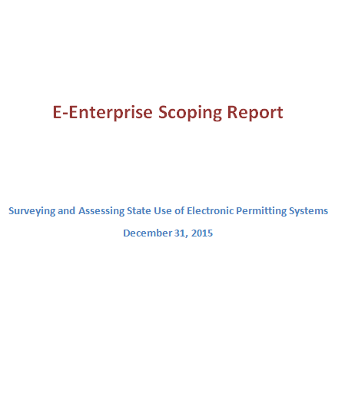
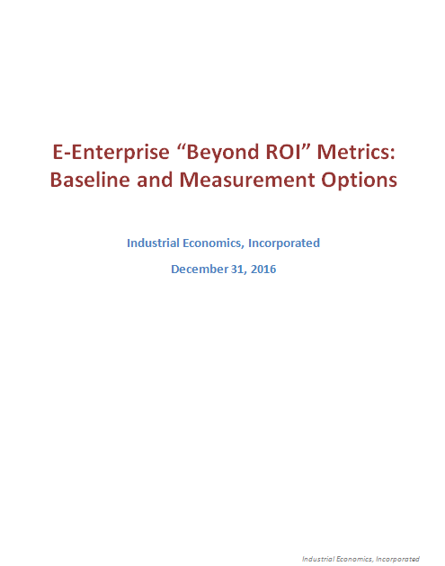
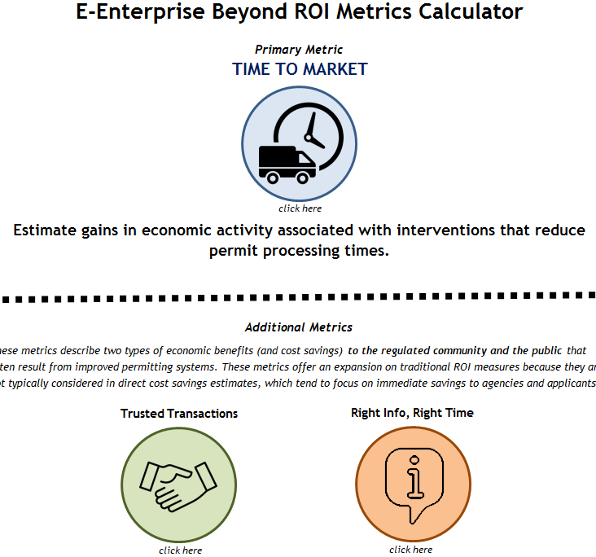
Inception & Background
2015 ePermitting scoping study commissioned by EELC, Georgia EPD and OLEM co-chair
  Workgroup members: GA VA CO DE SC MD AR IA OR OH, EPA: OW OAR OLEM
  GA conducted survey, responses from 35 states
  Recommendation: develop ROI metrics to enable state adoption of ePermitting systems
2016 Supplemental report: ROI metrics
  Methods/sources to calculate metrics and baselines
  State experiences, academic literature & public data
  Validated baselines & methods w/EPA NCEE
2017 ROI Calculator: Action Item from 4/16 EELC meeting to OLEM/CO, MA, DE co-chairs
    Tool for States to estimate potential increased economic activity, efficiency from ePermitting
    Commercial construction permits as proxy
Notes:
Specific Dates
Original charge to GA DEP and OLEM – Feb 15…1 scoping report done 12.31.15
b. Supplemental report on recommendations for metric baselines – done 12.22.16.
First demo of metric calculator – June 2017 (today)
Informal rollouts at Philadelphia Exchange Network Meeting

Slide 3
The ROI Calculator For States IS…
Intended for states; to help gauge impacts of potential streamlining efforts
Includes 3 metrics:
  Primary: Time to Market
  Additional: Trusted Transactions
  Additional: Right Info, Right Time
Captures economic impacts to industry & public from ePermitting or other process reforms (beyond cost and burden savings to agency)
Uses publicly-available economic (BEA) and labor rates data
Generates clear reports with estimates tailored to the states and industries chosen by the state user
Tribes can use the tool by selecting a bordering state to estimate impacts in their programs

Slide 4
The ROI Calculator is NOT…
A data flow to EPA
A formal cost-benefit analysis
    Scenario analysis tool
A way to estimate cost savings/burden reductions to internal State agency or EPA budgets
  Focus is on macroeconomic benefits to industry & public
AND… it is not onerous to use
  Enter available data and/or tailor the national averages provided
  For data users do not have, tool will provide evidence-based baselines and estimates based on user-entered values.

Slide 5

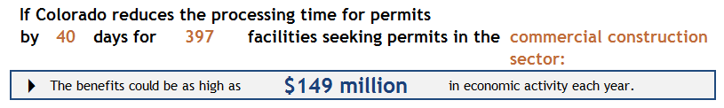
Primary ROI Metric: Time to Market
Time to Market: Estimate gains in economic activity associated with reduced permit processing times.
How does it work?
Based on World Bank assessment of permit processing time as a barrier to economic activity
Suggests use of commercial construction permits as “default industry”: in all 50 states, requires permits, used by World Bank as proxy, comparable in size to other sectors requiring environmental permits
User enters:
  State
  Industry (if improved process targets permits affecting specific industry)
  Number of facilities / percent of industry affected
  Pre-improvement permit processing time
  Post-improvement permit processing time
e.g., Colorado
e.g., Commercial construction
e.g., 50%
e.g., 80 days
e.g., 40 days
(50% reduction)
Output
Notes:
The model recommends that you select "commercial construction" as a default proxy for economic activity when the sector is unknown, or when multiple sectors are affected by a permit. Commercial construction is considered a reasonable indicator of "typical" economic activity in this context because:
1) it is similar in scale(size, in percentage of GDP) to other key sectors that require environmental permitting, such as the waste remediation sector;
2) it is present in all 50 states;
3) It explicitly requires permits to begin operation at most sites.
4) It is used by the World Bank as a consistent metric for the intersection between economic activity and permitting

Slide 6


Additional ROI Metrics
Two metrics that describe economic benefits (cost savings) to the regulated community and the public from ePermitting streamlining.
Trusted Transactions
Right Info, Right Time
Gains in productive value-added time for industry when uncertainty in the review process is reduced
Increased economic activity from efficiency in requesting and accessing information
Trusted Transactions: quantifies the value to regulated entities of realigning compliance staff to additional value-added use due to reductions in uncertainty in information exchanges and indeterminate schedules
  Key inputs: compliance staff wage rates; number of interactions
    Sources & Literature: Thomson Reuters, Cost of Compliance 2015; U.S. Census Bureau, Statistics of U.S Businesses – fully-loaded wage rate for compliance officers.
Right Info, Right Time: estimates benefits of reducing time spent by public/industry on searching for/accessing data (e.g., online driver’s license renewals vs. in-person)
  Key inputs: number of transactions/requests, average wage rate, % reduction in time to complete transaction/request
    Sources & Literature: Deloitte, Digital Government Transformation (for Australia), 2015; Bureau of Labor Statistics, National Occupational Employment and Wage Estimates.
Notes:
List out published the studies that provide baseline data for both.

Slide 7

Access the Tool

Slide 8
Questions and Discussion

Slide 9
Comments welcome by July 13 to:
David Nicholas, US EPA OLEM
nicholas.david@epa.gov
202.566.1927

