Slide 1
Technology Library
Sprint 1 Findings
December 18, 2020

Slide 2
Purpose
Summarize Sprint 1 interview results

Slide 3
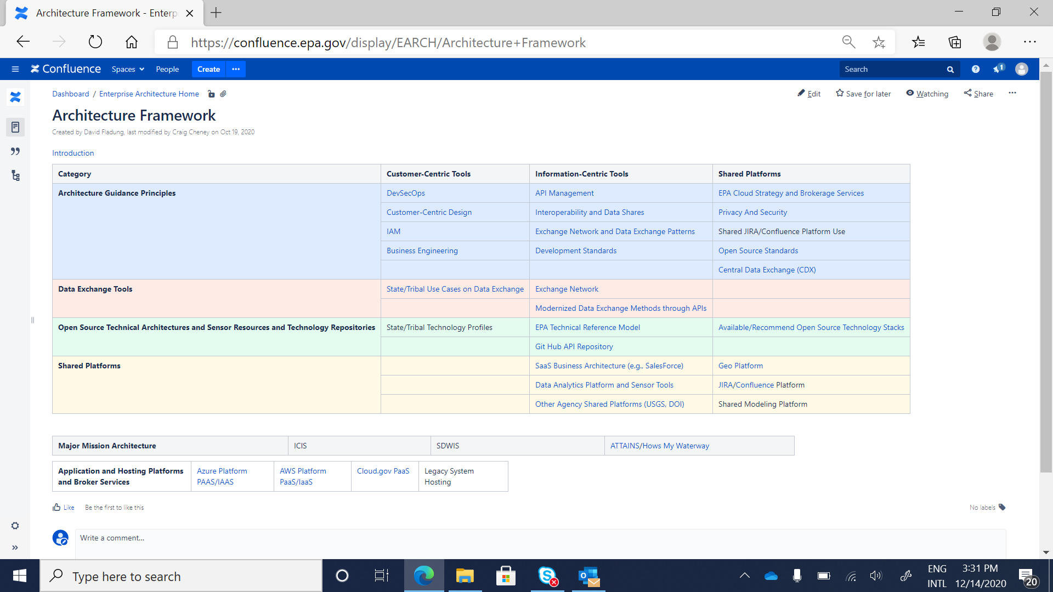

Slide 4
Sprint 1 Objective & Participants
Objective: Conduct discovery interviews with key stakeholders to obtain their initial input on the “Target Architecture”
Participants:
  Dalroy Ward, EPA OMS
  Steve Fine, EPA Office of Air and Radiation
  Kari Hedin, Fond du Lac Band of Lake Superior Chippewa
  Joe Carioti, EPA OMS
  Henry Perillo, EPA OMS (3-month EPA experience)
  Sarah Harrison, EPA Office of Air and Radiation, Data Analyst, (1 year EPA experience)
  Stephen Forrest, Montana

Slide 5
Sprint 1 Findings
Reconsider the name—Target Architecture does not resonate with all audience groups
  Suggestions: “library,” “playbook,” “resource,” “hub,” and “network”
Present content consistently using a template with consistent headings
  Potential organization: Description; Benefits; When to apply/when does this fit?; Caveats/Constraints
  Templates should organize the information by personas
    The top of the page should include an overview for managers and the page should get more detailed for technical SMEs

Slide 6
Findings (cont.)
Evaluate whether the matrix is the best presentation approach
  Consider developing business function survey questions to guide users to find the content they need (e.g., How do I flow air data to EPA?”)
Develop metadata schema and ensure tagging is a core requirement
  Many of the documents are relevant to multiple areas so need way to link the data through metadata.
  Consider Knowledge Management Best Practices.
    Include knowledge management and/or library manager in focus group
Develop a goal statement
  Draft: Provide a library of best practices and modern IT techniques for IT system owners and developers

Slide 7
Findings (cont.)
Ensure the library reflects the Digital Strategy philosophies – e.g., Rent, Buy, Build.
  New content should be vetted against the philosophies
Ensure case studies have consistent structures
  Include explanation of the case study with the link
  Ensure all documents have dates
Limit acronyms, use plain language whenever possible

